Slide 1



L16 – Uncorrelated Track Processing
By: Kyle Galang, Aurela Broqi, Ruben Dennis, Aaron Nogues, Ezra Stone
Notes:
- FILL IN / REMOVE ALL NOTES

Slide 2
Table of Contents
Requested Documents
Automatic Evaulator Script
UI Specifications
Documentation
Questions

Slide 3

Requested Documents
Aurela Broqi: Passport
Kyle Galang: Passport
Ruben Dennis: Passport
Aaron Nogues: Passport
Ezra Stone: Passport

Slide 4
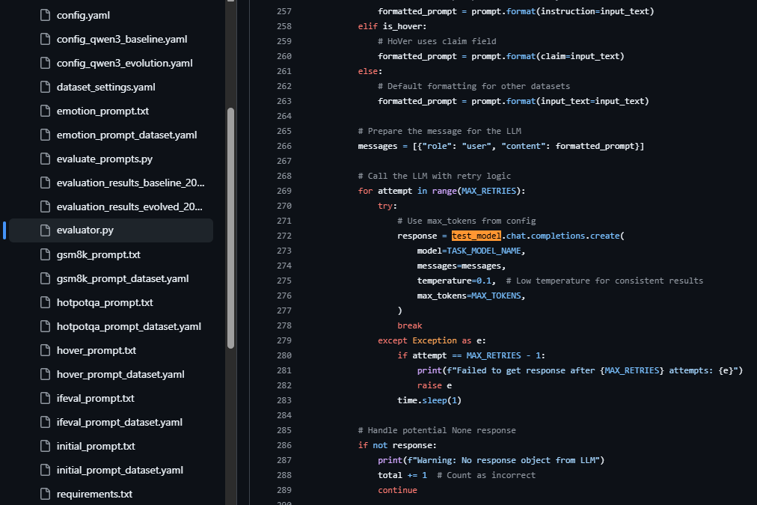
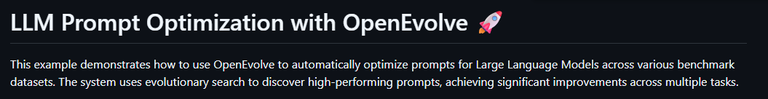
Automatic Evaluator Script
OpenEvolve has LLMs evaluate the prompts for LLMs in their evaluator script.
Their evaluator script specifically pings the LLMs.
Possibility of auto generated evaluator script

Slide 5
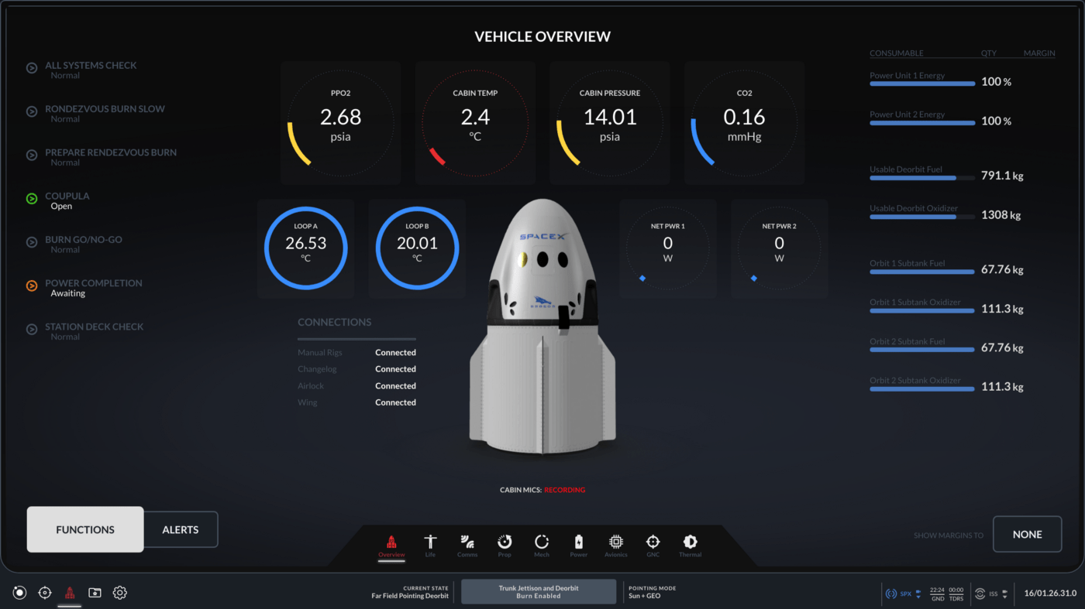
UI Specifications
Is there anything in specific that the Air Force wants in this UI? We are currently trying to create schematics for the UI to understand what type of tech stacks to use. - Currently we are looking at telemetry dashboards, but instead of telemetry data we are showcasing graphs as the iterations run through for real time analysis. So in this case we do not have to go through each iteration and see the evaluation.

Slide 6
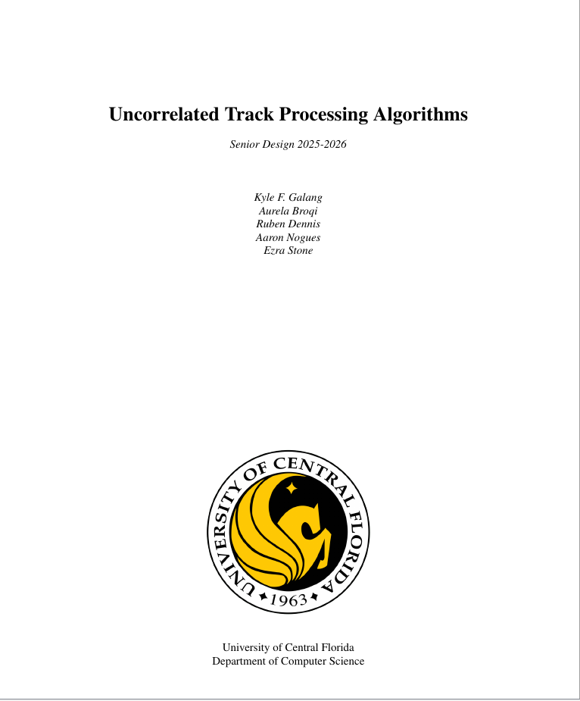
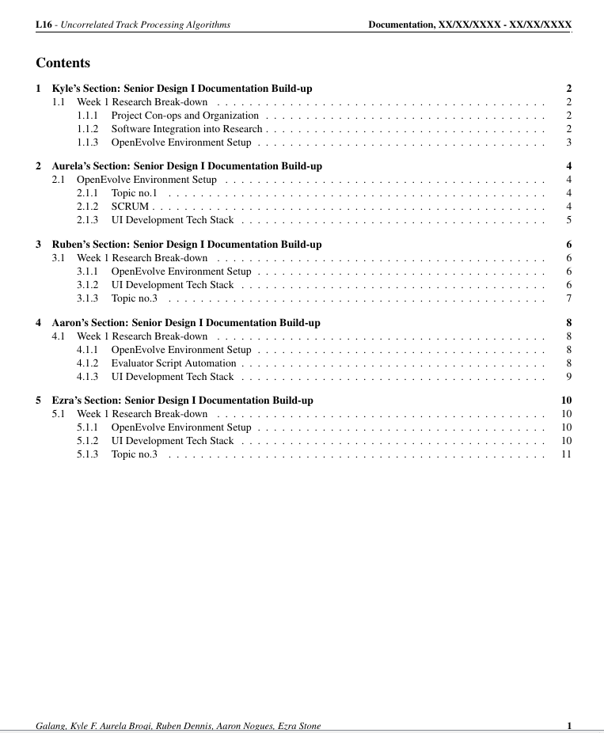
Documentation

Slide 7
Questions
Open discussions

